Slide 1

Dashboards for River Rejuvenation Projects
Nitesh Sabne

Slide 2
Mapbox API

Slide 3
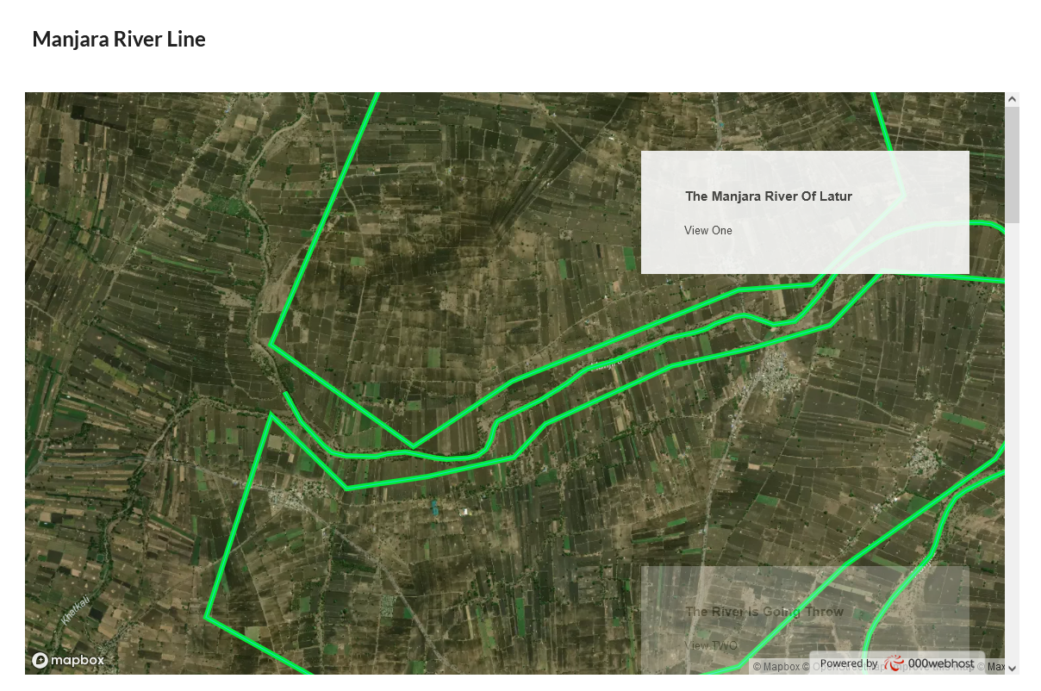
Manjara River Line
Started using Mapbox
Studied commands
Hosted website with database
Created basic dashboard view to observe river line
Used Javascript APIs to create maps and views

Slide 4
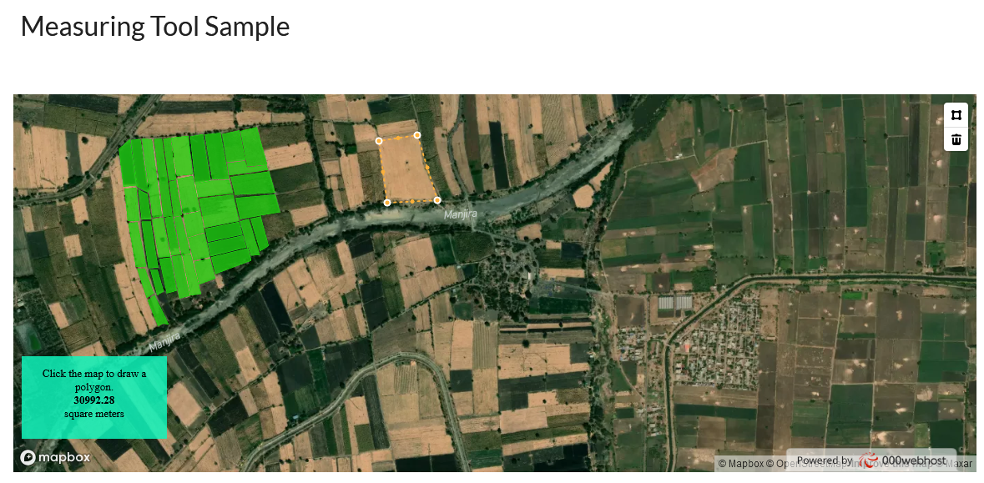
Area Measurement View
Mapped sample agricultural land in the Manjara River Basin
Create an area measurement view for mapped agricultural land

Slide 5
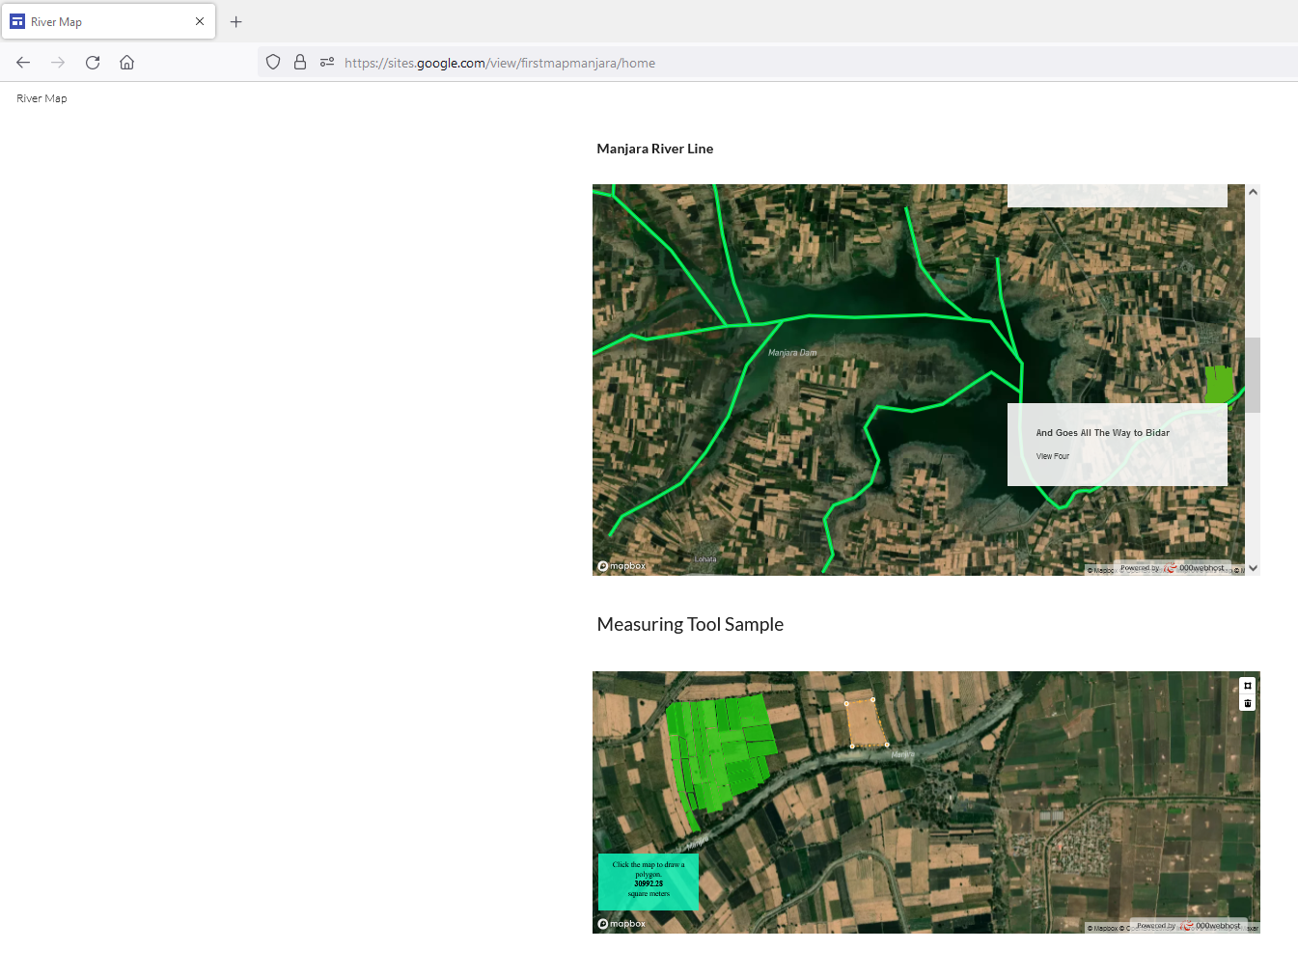
Website
https://sites.google.com/view/firstmapmanjara/home
Created website and added both the view for testing
Publish website

Slide 6
Study of Current Dashboards

Slide 7
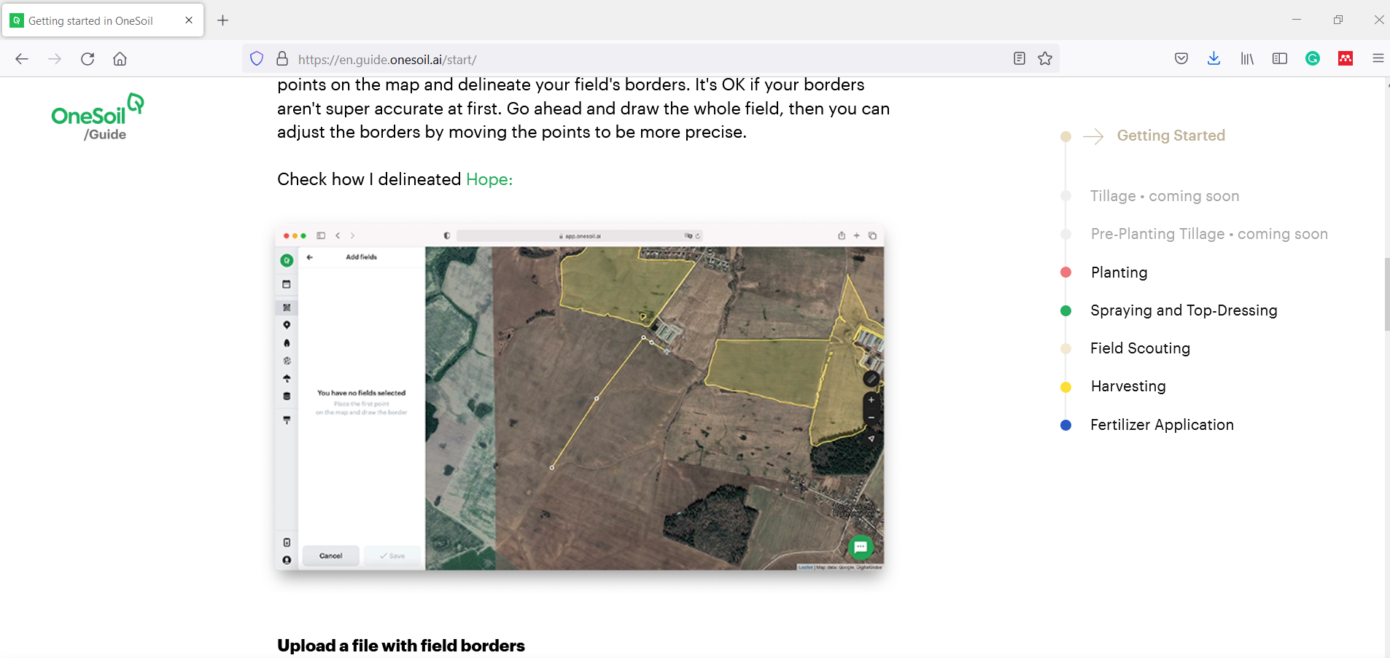
Onesoil
Searched for AI and ML platforms used for agricultural mapping
Found Onesoil made using mapbox

Slide 8
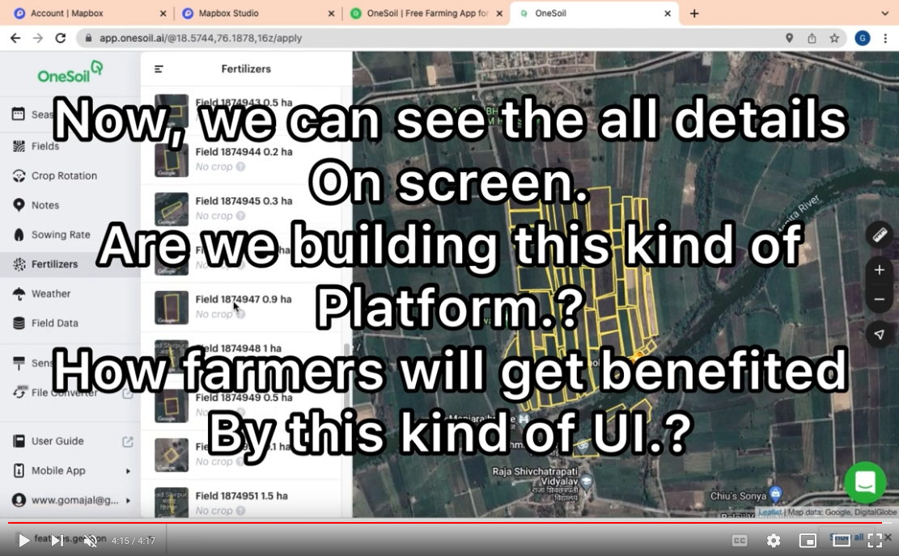
Onesoil
Studies the onesoil platform
Tried onesoil for manjara river agi land data
Created Explanation Video
https://www.youtube.com/watch?v=U16JeevDU3g

Slide 9
Dashboarding Function

Slide 10
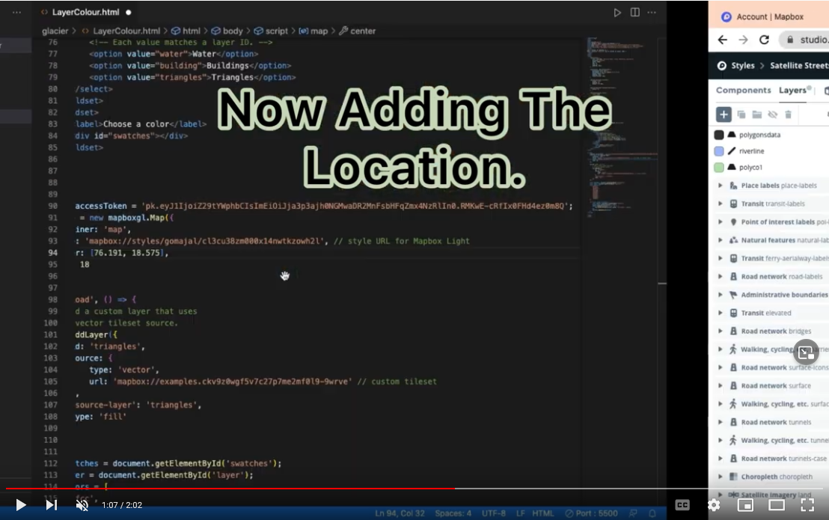
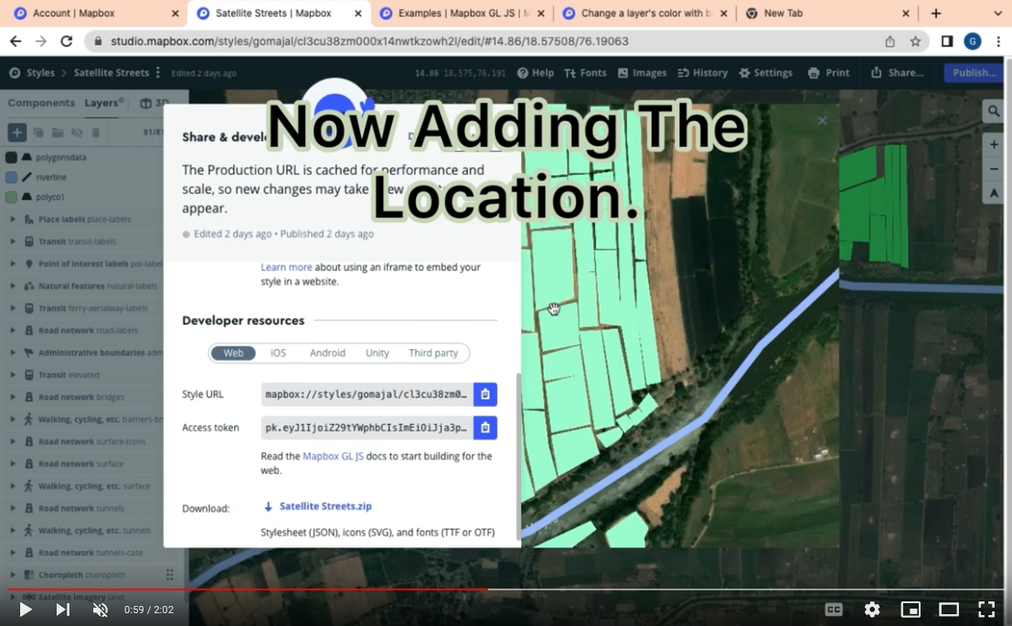
The Polygons Colour Change Problem.
Worked on changing colors of agri polygons based on status
Did multiple itteraions with Javascript code
Created Video of the work - https://www.youtube.com/watch?v=qIzdiHu6LJI&t=2s
Sample Code on Github - https://github.com/NiteshSabne/gomajalriverline

Slide 11
Mapping Activity Management

Slide 12
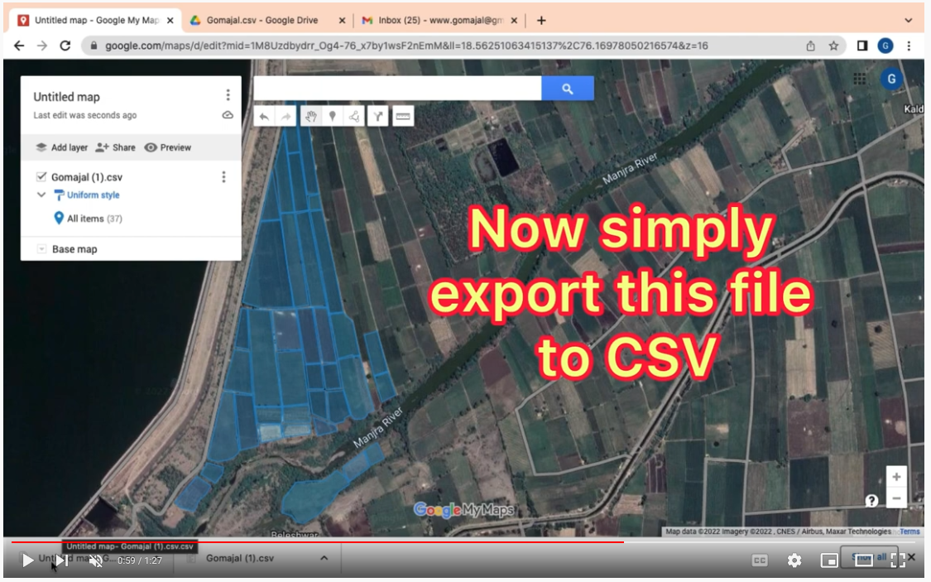
Managing Coordinating Agri Polygon Drawing Work
Created mechanism to handle polygon drawing by multiple people
Video - https://www.youtube.com/watch?v=FHgSt49WCdk

Slide 13
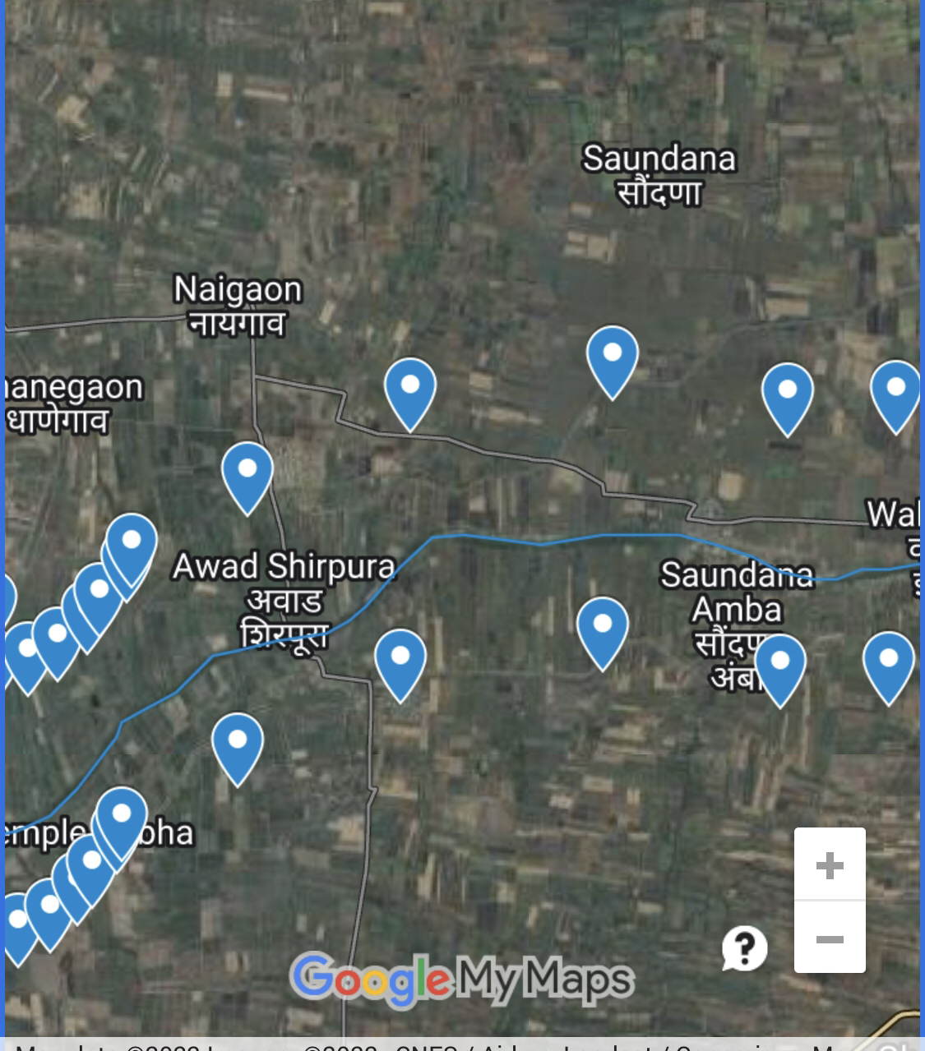
River line 1 Km on both sides of river
Written code to automatically draw river line 1 km on both side of center line

Slide 14
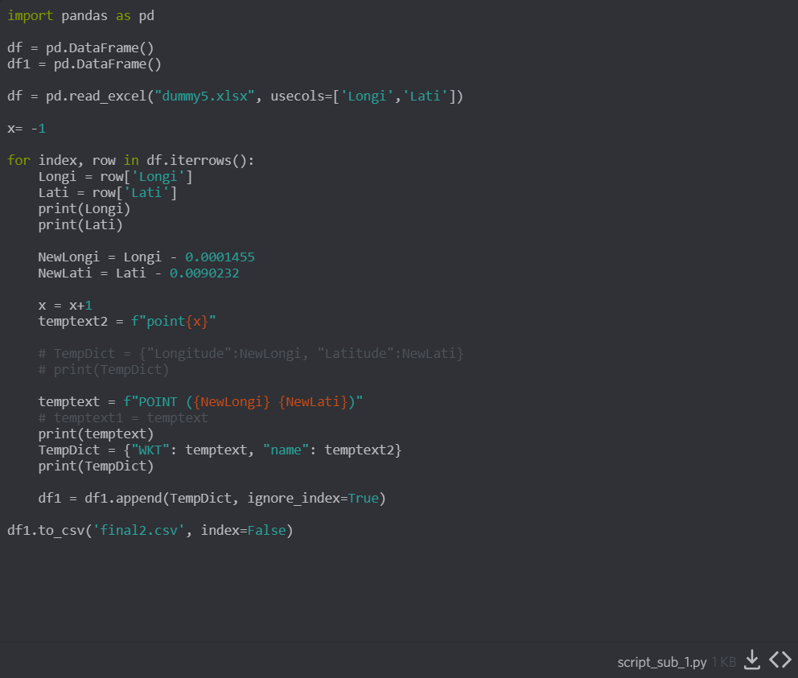
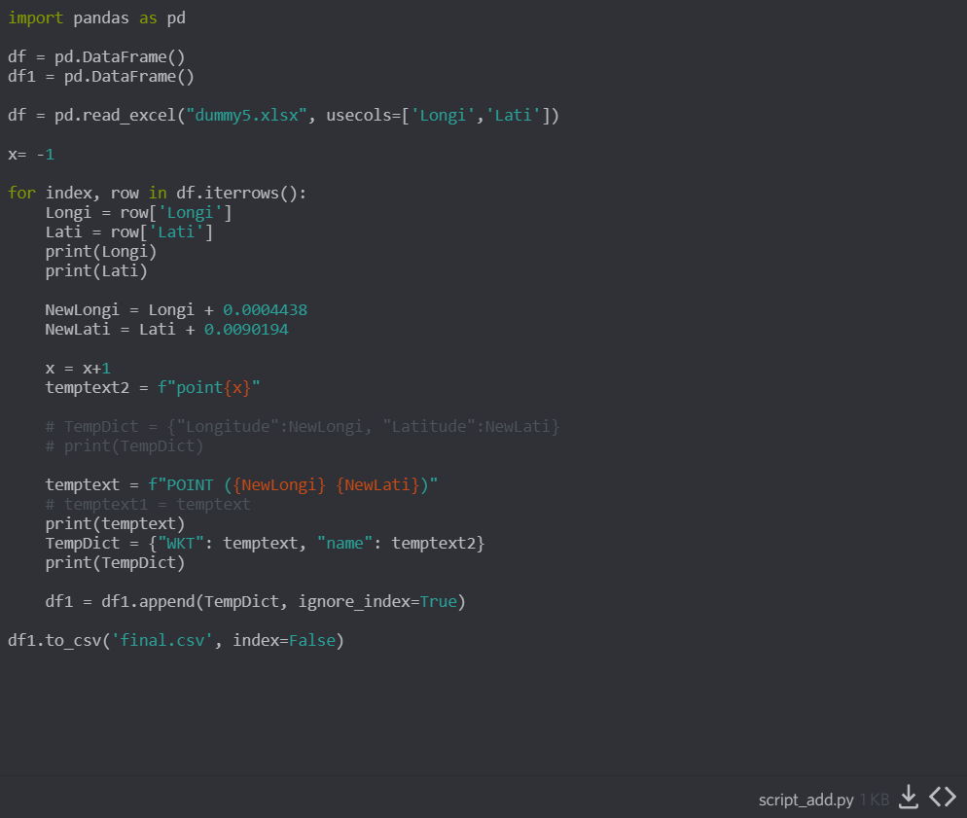
River line 1 Km on both sides of river
Arranged Python code that import excel and output csv code that can be imported in the google earth and mymaps

Slide 15
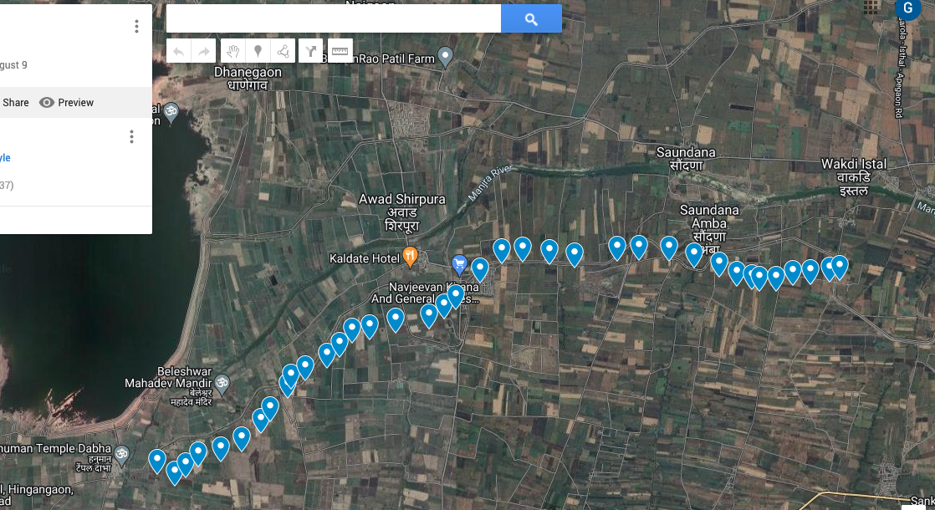
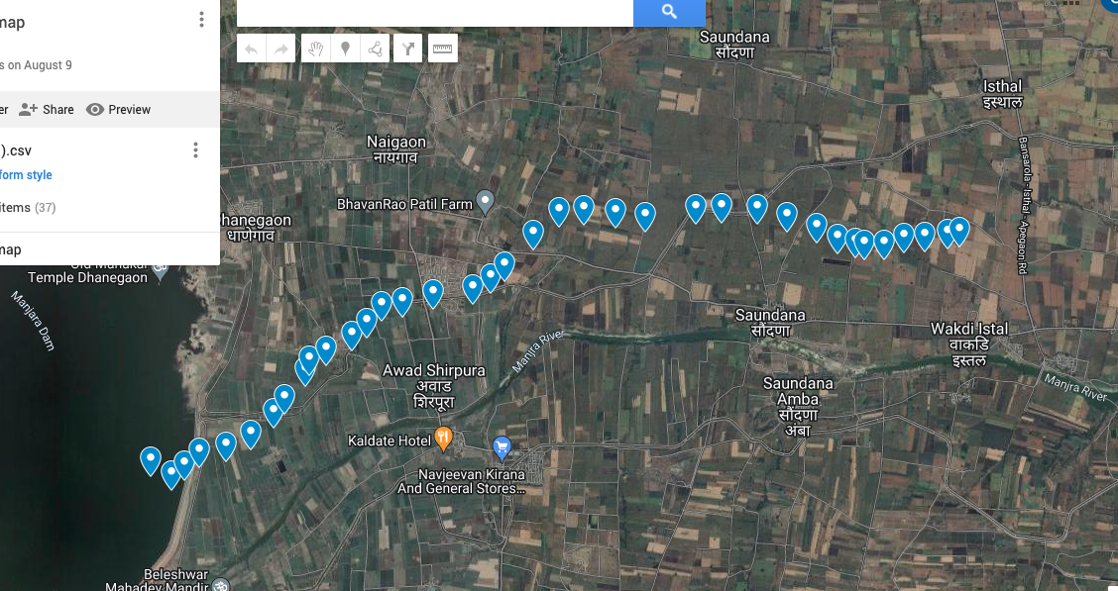
River line 1 Km on both sides of river

Slide 16
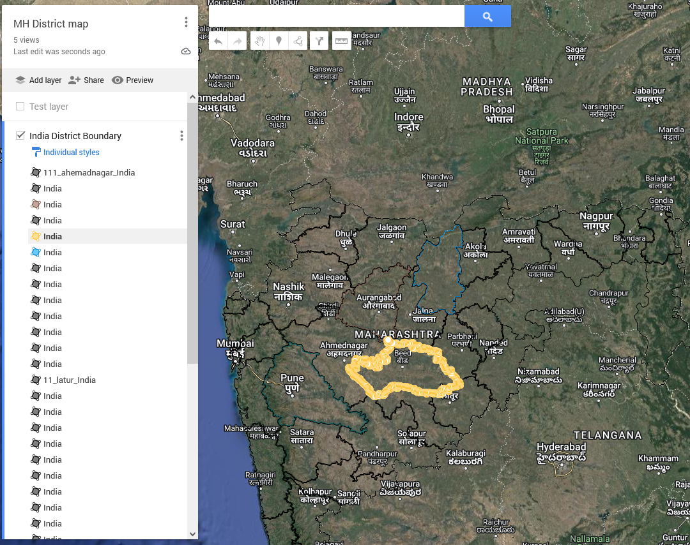
Managing and Coordinating District Mapping
Created District Boundary maps of districts using opensource data
Separated data for students mapping activities
Created district data of states such as Maharashtra, Tamil Nadu, Telangana and Uttar Pradesh

Slide 17
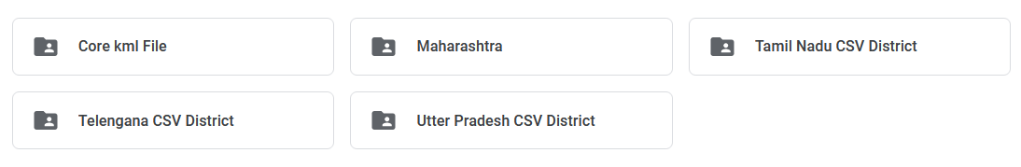
Managing and Coordinating District Mapping
Continuing District Map Extraction

Slide 18
Thank You

